Slide 1
Emergence of Scaling in Random Networks Summary and Review
By: Jeff Hildebrandt

Slide 2
Overview of the paper
Gives methods for describing large expanding systems
The systems are composed of vertices and edges that link the vertices
The systems are constantly adding new vertices and new edges are added
The paper gives equations for predicting exactly how these networks expand
The systems are referred to as Scale-free networks
Notes:
* Scale free networks are networks that have a power-law degree distribution

Slide 3
Examples of the systems described in this paper
Genetic network
Vertices are proteins and genes
Edges are the chemical interactions between them
Nervous system
Vertices are the nerve cells
Edges are axons
Social science
Vertices are individuals or organizations
Edges are the social interactions between them
Internet
Vertices are web pages
Edges are links

Slide 4
Motivation
No good way to describe systems composed of nonidentical elements that have diverse and nonlocal interactions
Doing so would advance many disciplines
Now large systems are well documented
Current models don’t consider the growth and preferential attachment of new vertices of the systems
Emergence of detailed topological data for some systems thanks to databases and the internet

Slide 5
Goal
Predict how networks with complex topology will grow
Find where new vertices are added
Explain how these systems self organize
Expand upon current models of how networks with complex topology already exist, with how they expand and where new vertices want to attach themselves

Slide 6
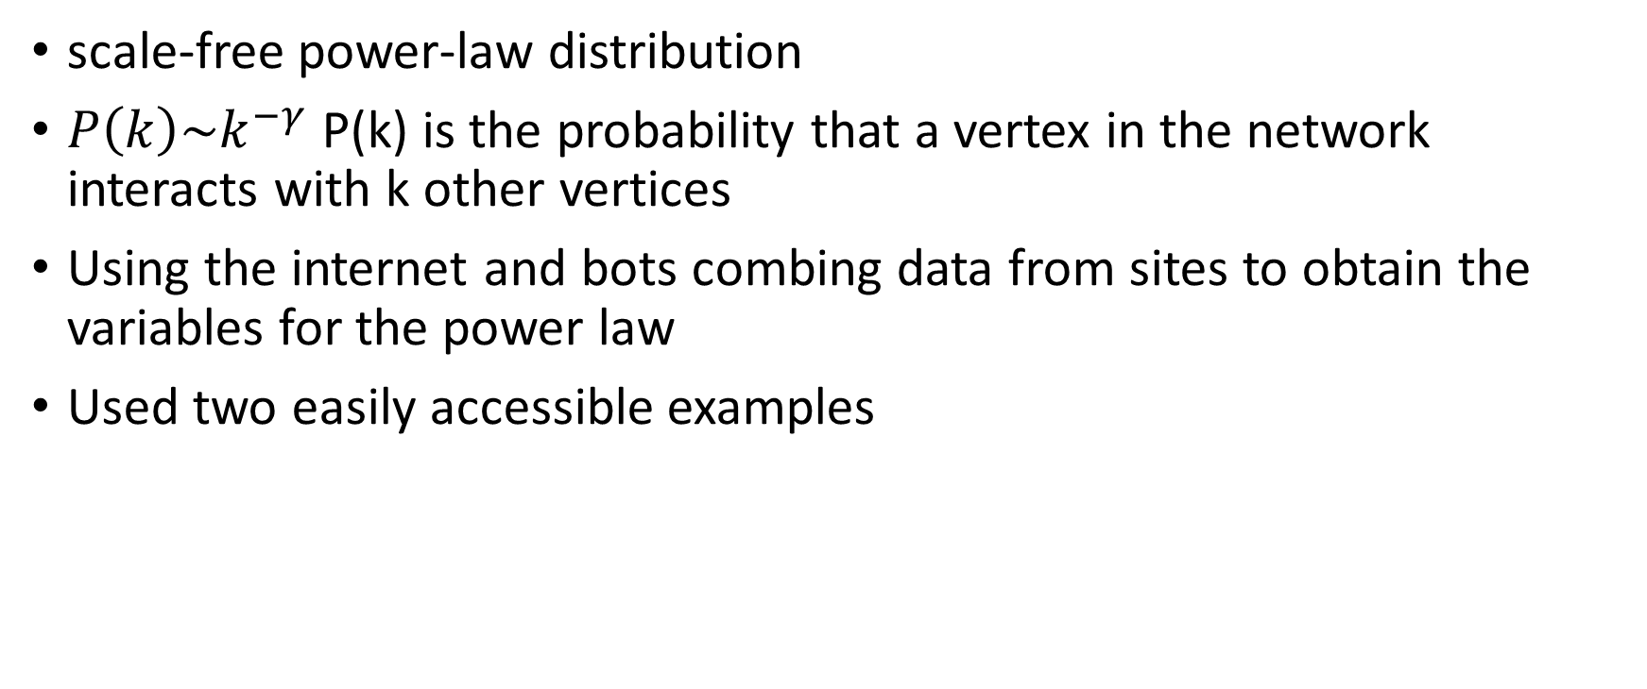
Method
scale-free power-law distribution
$P\left(k\right)\sim k^{−γ}$ P(k) is the probability that a vertex in the network interacts with k other vertices
Using the internet and bots combing data from sites to obtain the variables for the power law
Used two easily accessible examples

Slide 7
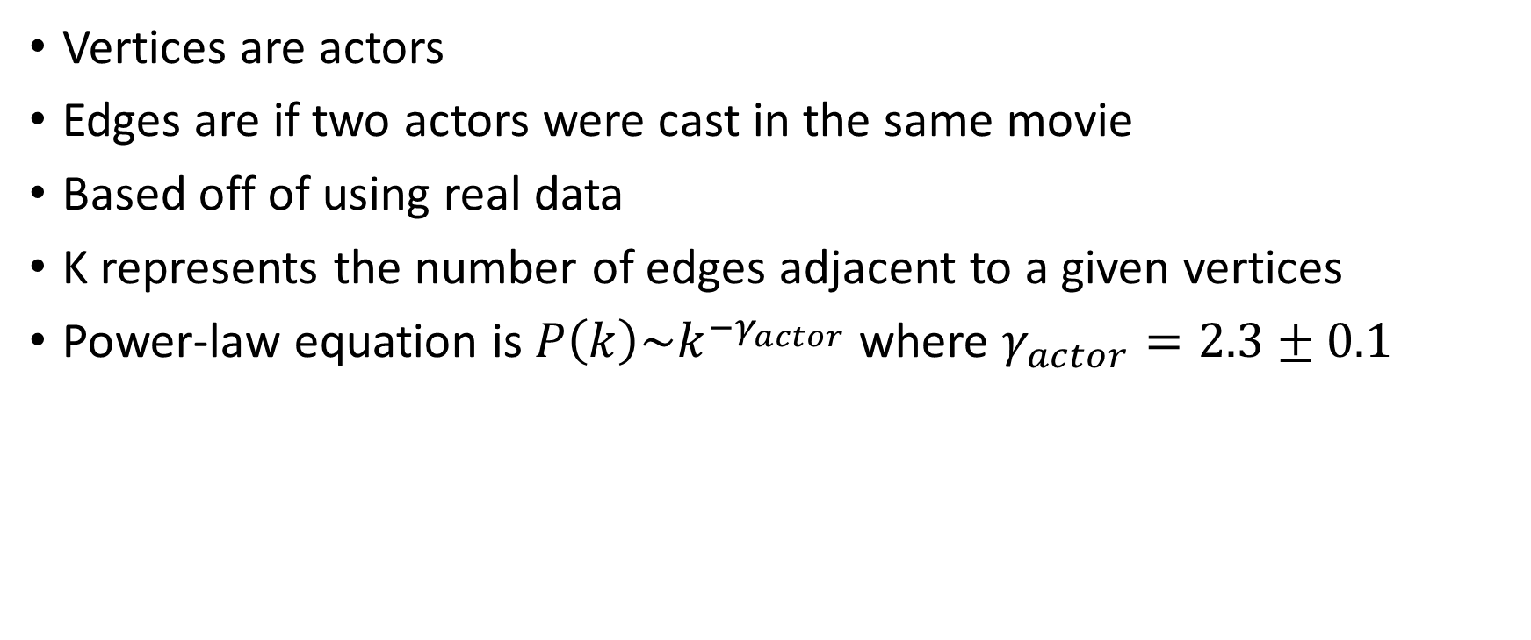
Collaboration graph of movie actors
Vertices are actors
Edges are if two actors were cast in the same movie
Based off of using real data
K represents the number of edges adjacent to a given vertices
Power-law equation is $P\left(k\right)\sim k^{{−γ}_{actor}}$ where $γ_{actor}=2.3±0.1$

Slide 8
Internet
Vertices are web pages
Edges are links
Used bots to comb the web to collect hyperlinks to other web pages
Ywww = 2.1 +- 0.1

Slide 9
Electric power grid in the US
Reflects the historical patterns of urban and industrial development
Vertices are generators, transformers and substations
Edges are power lines
Only 4941 vertices
Due to small number of vertices the scaling region is less prominent
Ypower ~= 4

Slide 10
Connectivity of scientific publications
Ycite = 3

Slide 11
Power law for large k
Generally the exponent variable falls between 2.1 and 4

Slide 12
Existing Models for complex topology
Erdo˝s and Re´nyi
Assumes starting with N vertices and connect each pair of vertices with probability p
Watts and Strogatz
N vertices form a one-dimensional lattice, each vertex being connected to its two nearest and next-nearest neighbors. With probability p, each edge is reconnected to a vertex chosen at random.
Leading to six degrees of separation
Six degrees of separation is the idea that all living things and everything else in the world are six or fewer steps away (https://en.wikipedia.org/wiki/Six_degrees_of_separation)
Notes:
Several years ago, I heard a statistic about how I would be connected with a celebrity on facebook by going through 6 of my friends of friends

Slide 13
Fallacy of existing models
A common feature of the ER and WS models is that the probability of finding a highly connected vertex (that is, a large k) decreases exponentially with k; thus, vertices with large connectivity are practically absent
The power-law tail characterizing P(k) for the networks studied indicates that highly connected vertices have a large chance of occurring
In real world networks a high k occurs often. Think of celebrities followed on Instagram or papers cited in academia
Both assume that we start with a fixed number N, that are then randomly connected or reconnected without modifying N
Real systems the number of vertices N is constantly increasing
Assume connectivity is random and uniform, when in reality the connectivity of new nodes have preferential connectivity
Ex: a new actor is more likely to be case in a supporting role with an already established actor

Slide 14

New equation based off connecting new vertices to existing, well established vertices
Know the network connectivity of a node is based on $P\left(k\right)\sim k^{−γ}$
Have to devise an equation that fits that distribution, where some are above and some are below that general probability
“rich-get-richer” phenomenon

Slide 15
Strength 1
Gives examples of networks with lots of vertices and relatively small amount of vertices and did analysis of both
Helped the reader see a good example of the range of the exponent variable as well give the reader a reference for estimating the exponent variable for a system they might be studying

Slide 16
Strength 2
Takes the existing models and explains what is wrong with them and gives improvements to real systems
This shows that there is definitely more work to do in this field
Shows how their new findings relate to the real-world by using real, measurable examples

Slide 17
Strength 3

Slide 18
Weakness 1
Don’t explain the method of how they found the topology of the complex networks they analyzed
Unable to determine how good their results were
Makes it difficult to replicate their findings

Slide 19
Weakness 2

Slide 20
Weakness 3

Slide 21
Extension 1 – Analysis of Twitter users
Analyze followers
See trends of popular trends over time based off of new followers and links
Predict future trends based off of this data

Slide 22
Extension 2

